Slide 1

Same City New Hood
William james Ngana

Slide 2
Problem
Toronto is Canada's largest city, I has many different neighbourhoods with many communities. As a prospective business owner you when establishing your business you need to choose an area that would be optimal for you. The area that a business is built in can make or break it. Build in the wrong place a business can fail, but built in the right place the business will thrive and grow. Having a proper understanding of the community and the business that are already there is of great importance to prospective business owners.

Slide 3
Interest
This problem would be of interests to anyone looking to start a restaurant or getting into the restaurant business in Toronto and trying to identify a place to put it.

Slide 4
Data -Sources
The main source of data that I'm going to use in this project comes from https://en.wikipedia.org/wiki/List_of_postal_codes_of_Canada:_M this is a table of all the boroughs and neighborhoods in Toronto and their postal codes. I will also be making calls to Foursquare api and from there be able to extract relevant venue data for each borough. The api call will then return the a list of all the top 50 venues in the area and the type of venue it is
When all was said and done the final data frame had 182 different venues

Slide 5
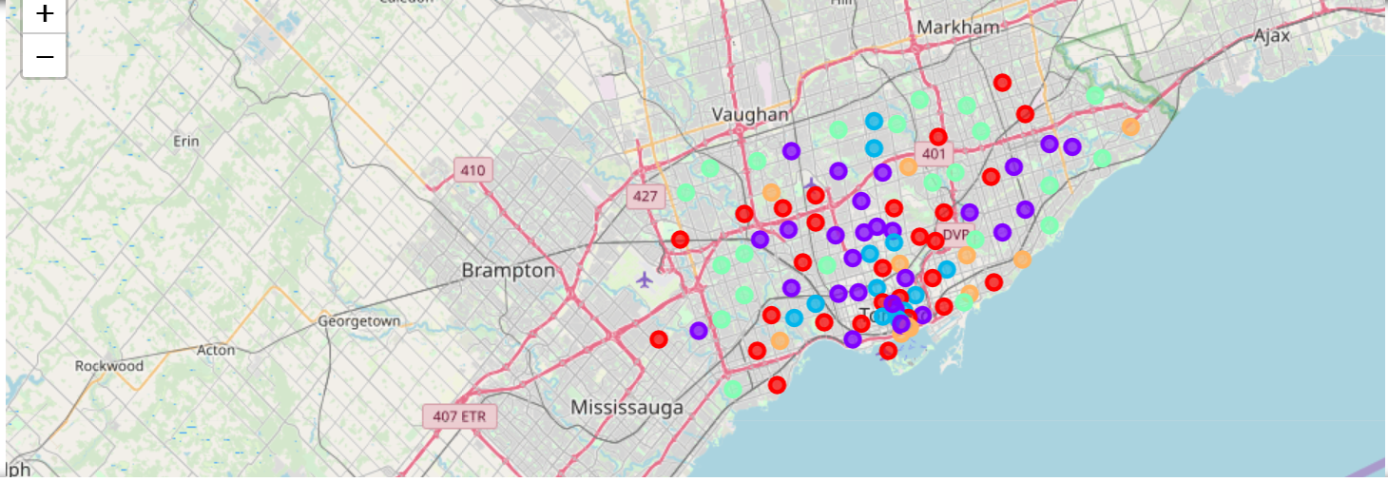
Clustering
This is the postal codes in Toronto clustered with each color being a different cluster group

Slide 6
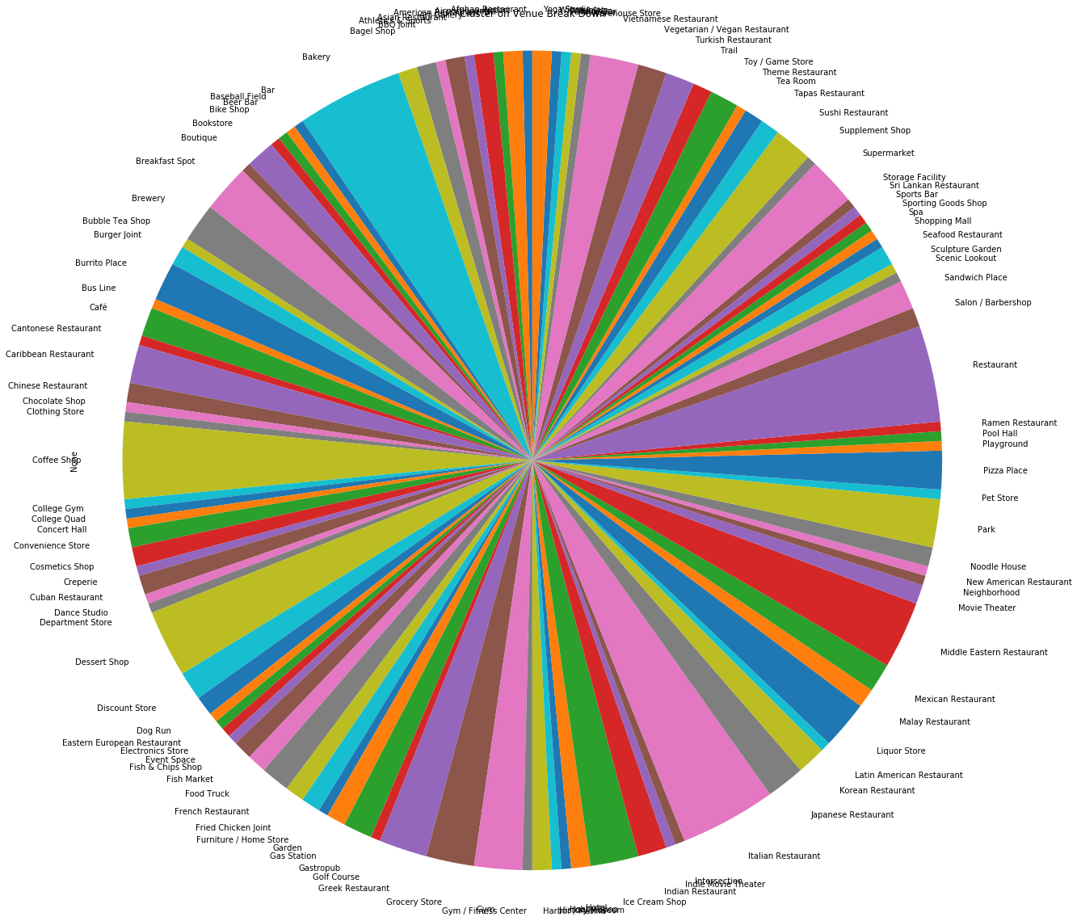
Cluster 1
This is the breakdown of the different venues in cluster 1. We can see that there is no dominate venue

Slide 7
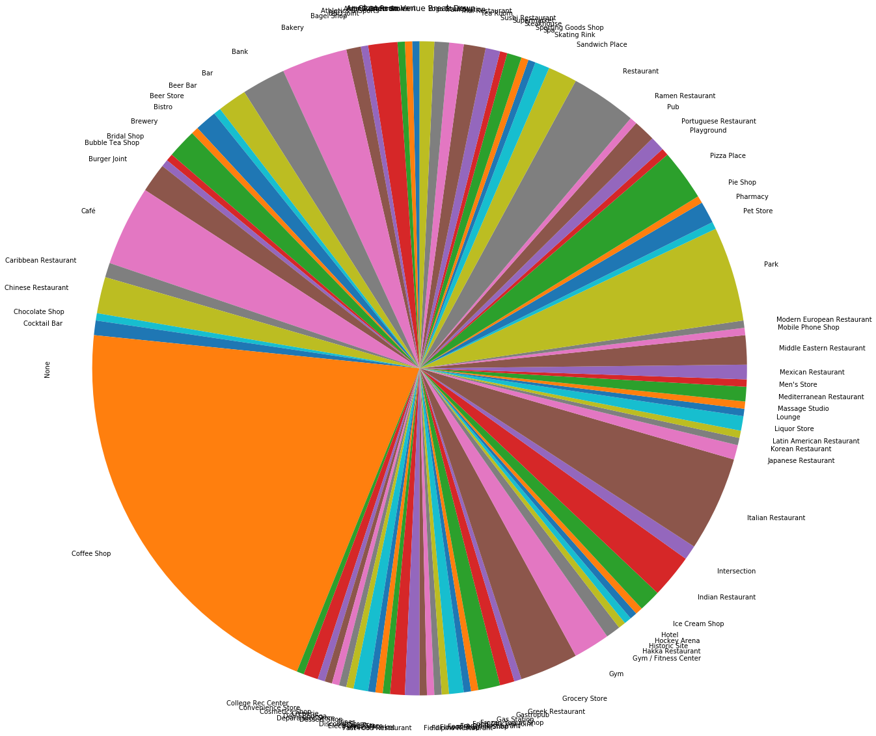
Cluster 2
This is the breakdown of the venues in cluster 2 we can see the dominate venue is coffee shop

Slide 8
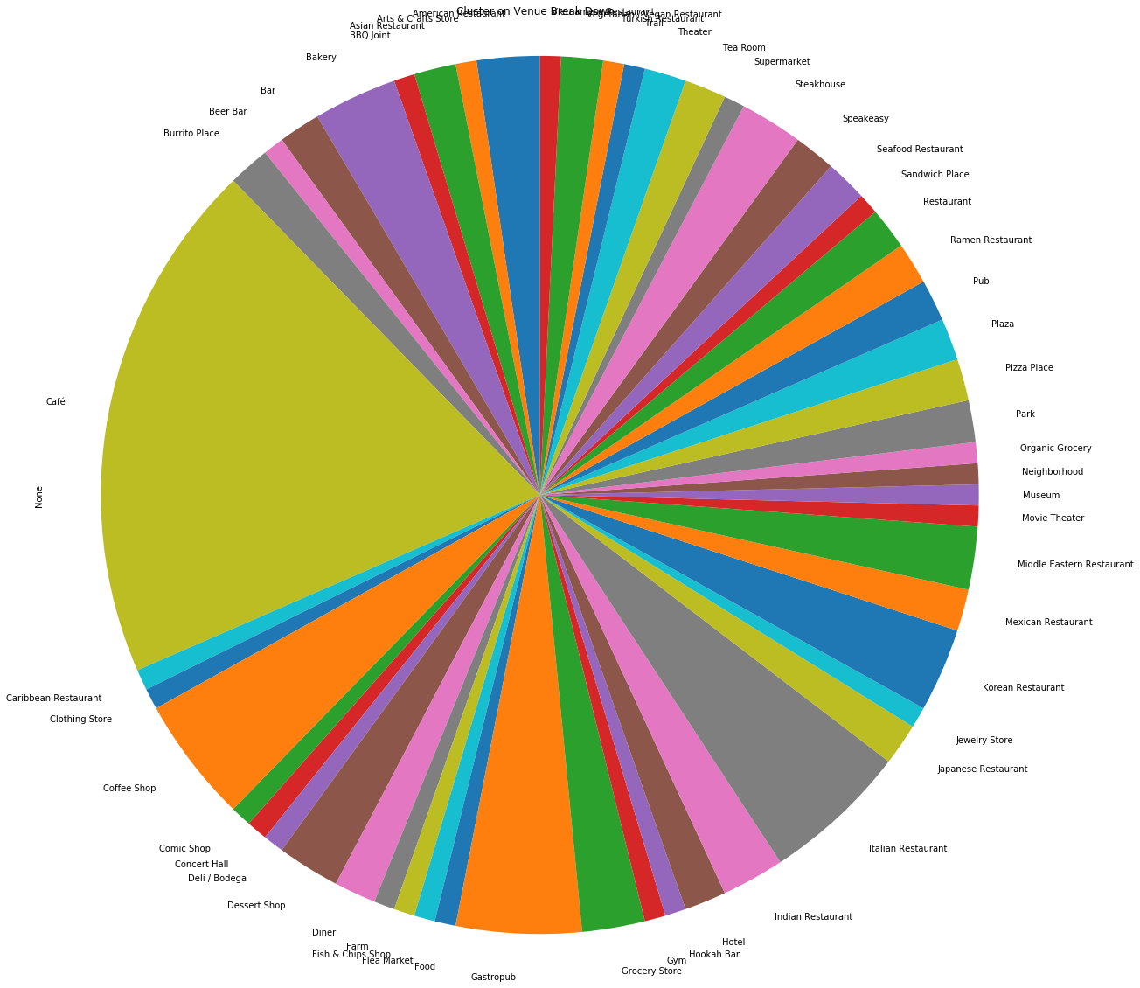
Cluster 3
This is a breakdown of the different venues in cluster 3 we can see the dominate venue is cafe

Slide 9
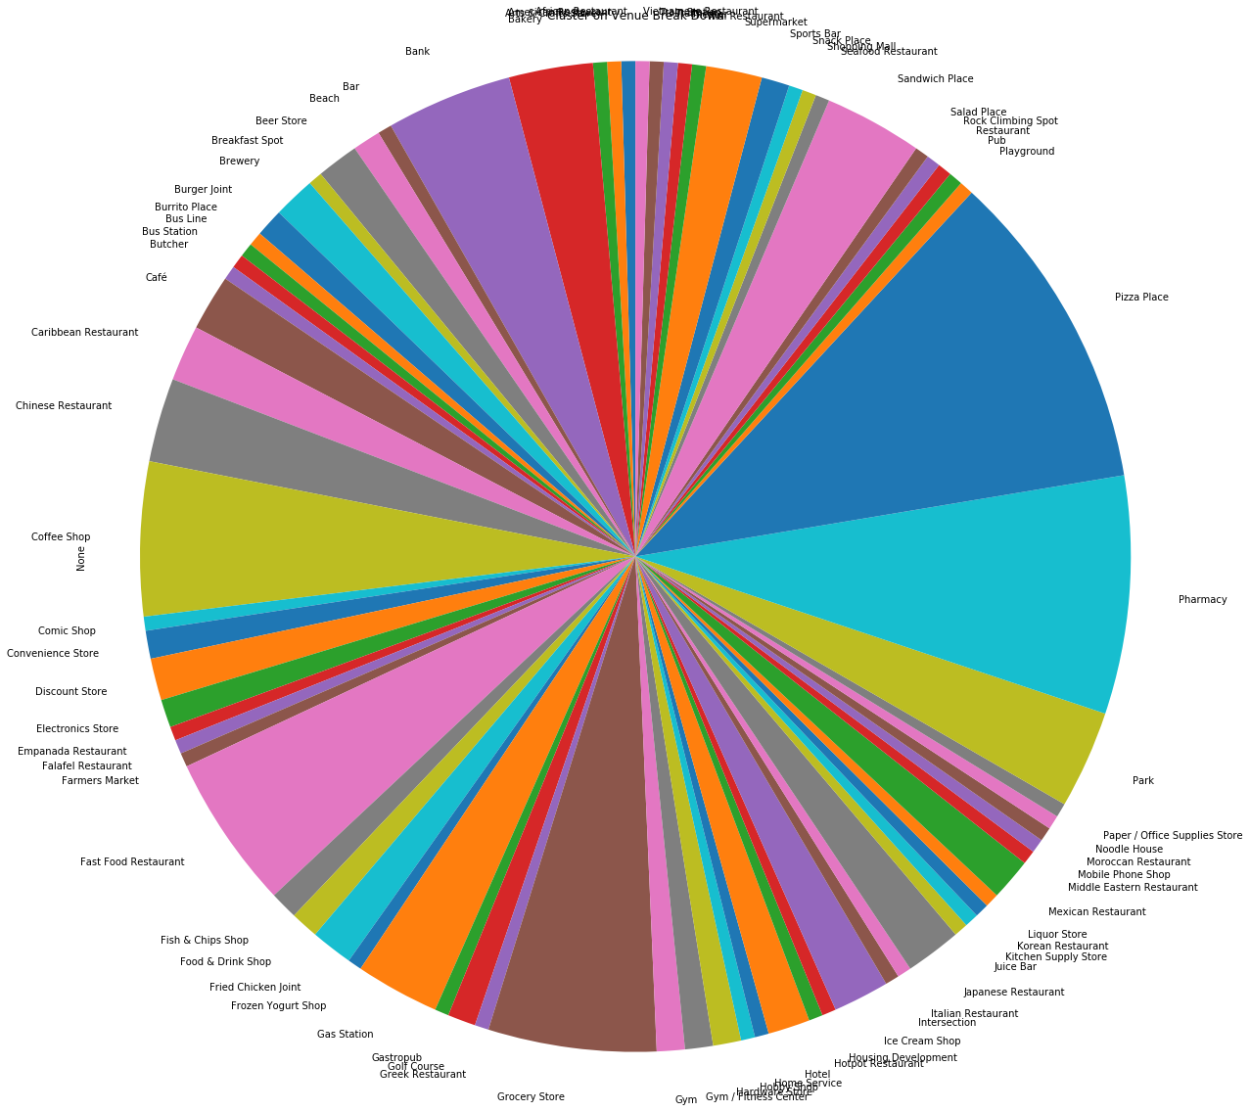
Cluster 4
This is a breakdown of the different venues in cluster 4 we can see the dominate venue is a split between pizza shop and phramacy

Slide 10
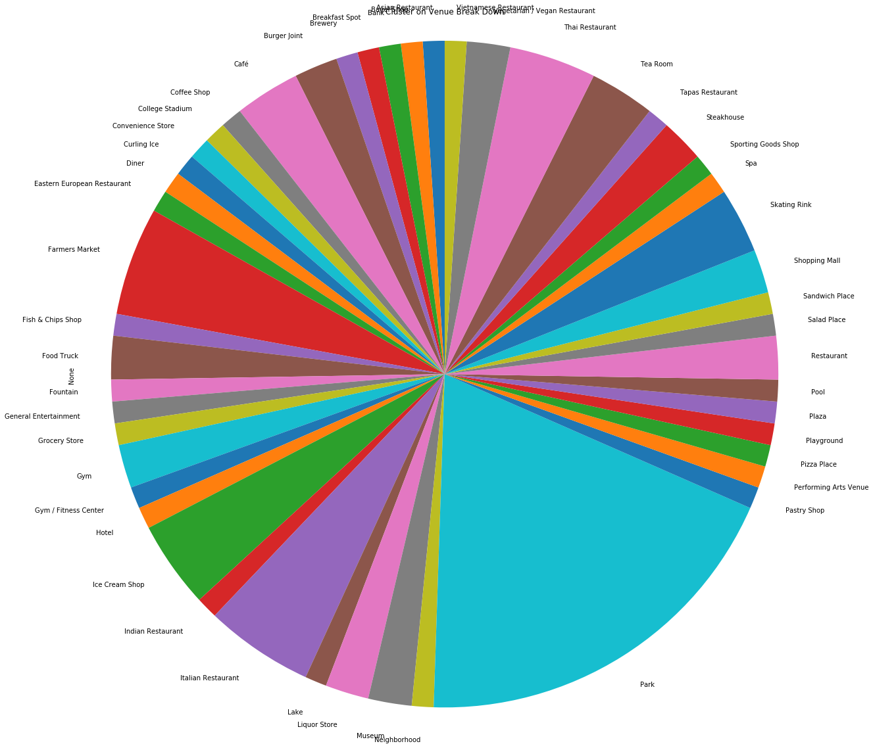
Cluster 5
This is a breakdown of the different venues in cluster 5 we can see the dominate venue is park

Slide 11
Conclusion and Next Steps
This is a very elementary look at the different postcodes in the city of Toronto. The next step into this analysis would be to look at a more in depth break down of the venues. Grouping each of them in to specific larger categories. For example all the restaurants get grouped together and from there we can find out in which postcodes restaurants do best in in general and from there we can the have a breakdown and look what kind or restaurant does better where. That or we can take a closer look at the current clusters that we have and look at economics of the areas. The different rent prices in the postcodes, and a demographic breakdown. All this would give us more information that will allow for a better grouping and for us to be better equipped to cluster the different postcodes in Toronto.

